Slide 1
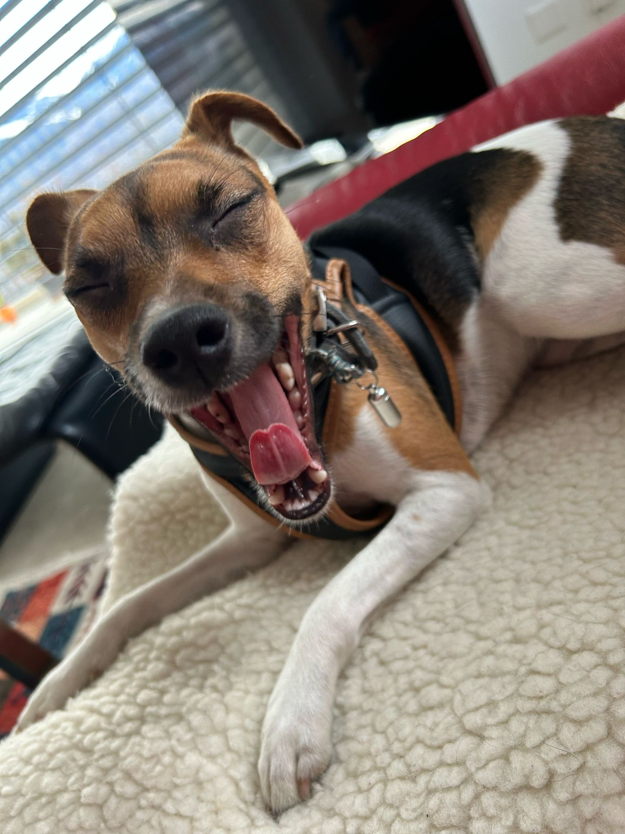
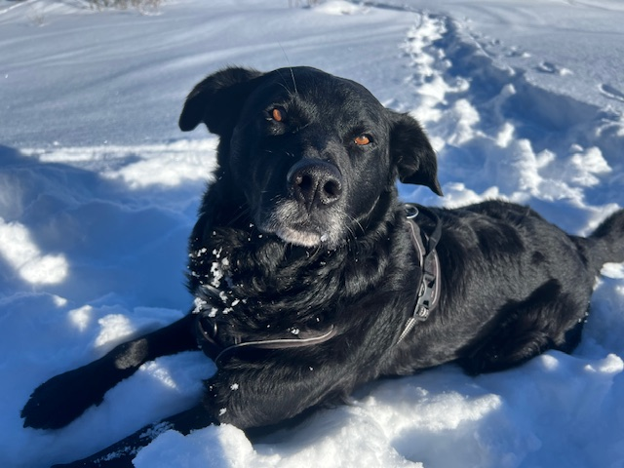
Dog Breed Identification

Slide 2
The Goal
On Kaggle.com we found a dataset with one of the best animals which exist: Dogs!
As we both love dogs, we decided to make a dog breed identification DL model
We thought our aim for this project is to mess a little bit with the input data and look how the model performs
Notes:
2

Slide 3
The dataset – The setup – The Goal
The dataset consists of 10’222 pictures of dogs
These are pictures of about 120 different breeds
The dataset is unbalanced. One breed is only represented 66 times whereas another breed is represented 126 times (more than the double!)
So, we decided to create 3 setups of the same dataset and use it as input for our DL model. The datasets are:
The dataset as it is
A reduced and balanced dataset (all breeds are represented 66 times)
An augmented and balanced dataset (all breeds are represented 126 times)
How do the different training datasets affect the model performance?
Notes:
3

Slide 4
The MobilenetV2… Selling argument from ChatGPT
We failed miserably with our try to tinker a replication of the Alexnet…
Luckily, Pascal came to aid and recommended us MobilenetV2
And this was the selling argument for us from ChatGPT:
Balanced Performance: MobileNetV2 strikes a balance between model size, computational efficiency, and accuracy, making it a popular choice for various tasks like image classification, object detection, and semantic segmentation on resource-constrained devices.
Performance was way better

Slide 5
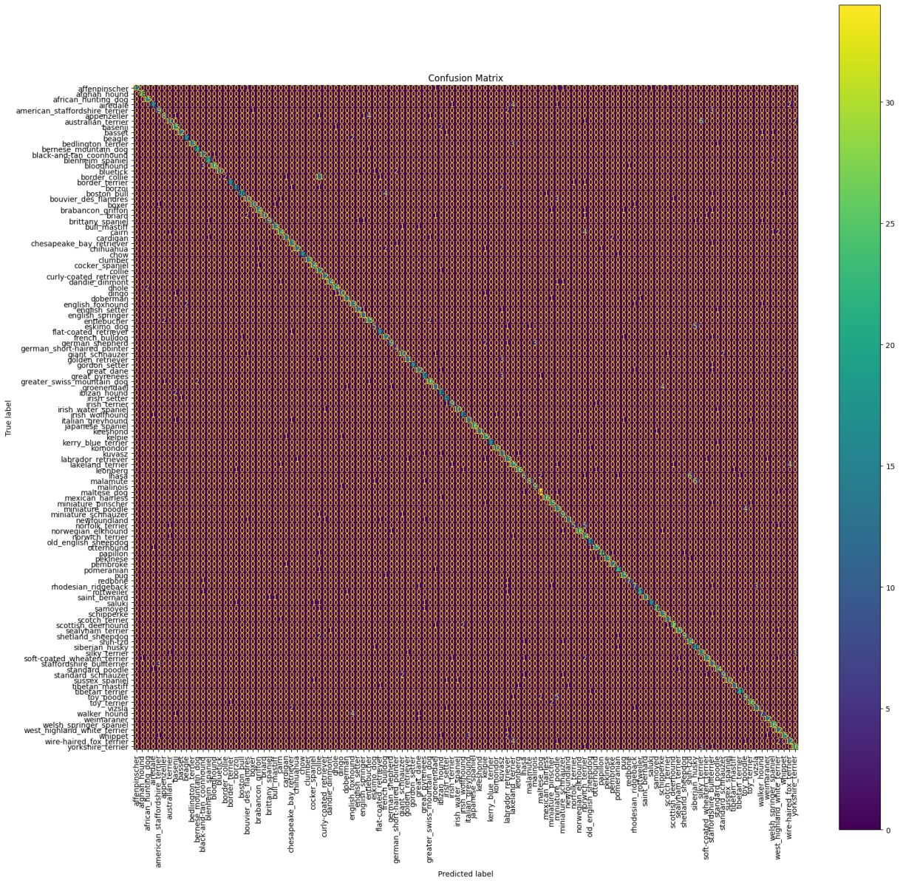
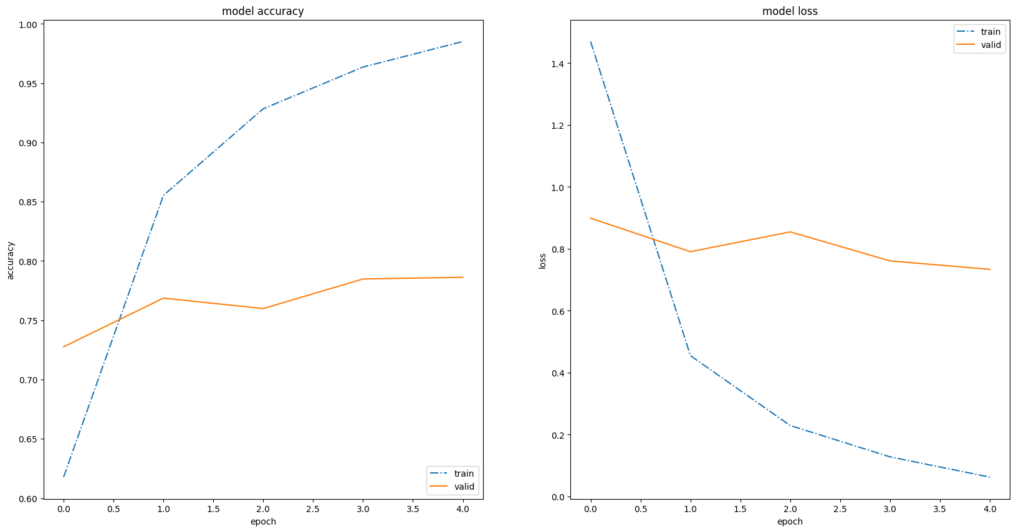
Model evaluation (1/2)
Example for an error:
Border Collie mistaken for a Collie
Lhasa mistaken for a Shih Tzu
Malamute mistaken for Siberian Husky
→ Mistakes because of similarities in appearance

Slide 6
Model evaluation (2/2)
Let’s look at the model accuracies:
Model 1 (unbalanced dataset): 79.85%
Model 2 (balanced and reduced dataset): 79.16%
Model 3 (balanced and augmented dataset): 75.84%
The baseline accuracy was 0.83% so the DL models performed extraordinary in comparison
The unbalanced dataset delivered the best result
The reduced dataset was a bit less accurate
However, the augmented dataset made the model even worse… so augmentation doesn’t always seem to be helpful

Slide 7




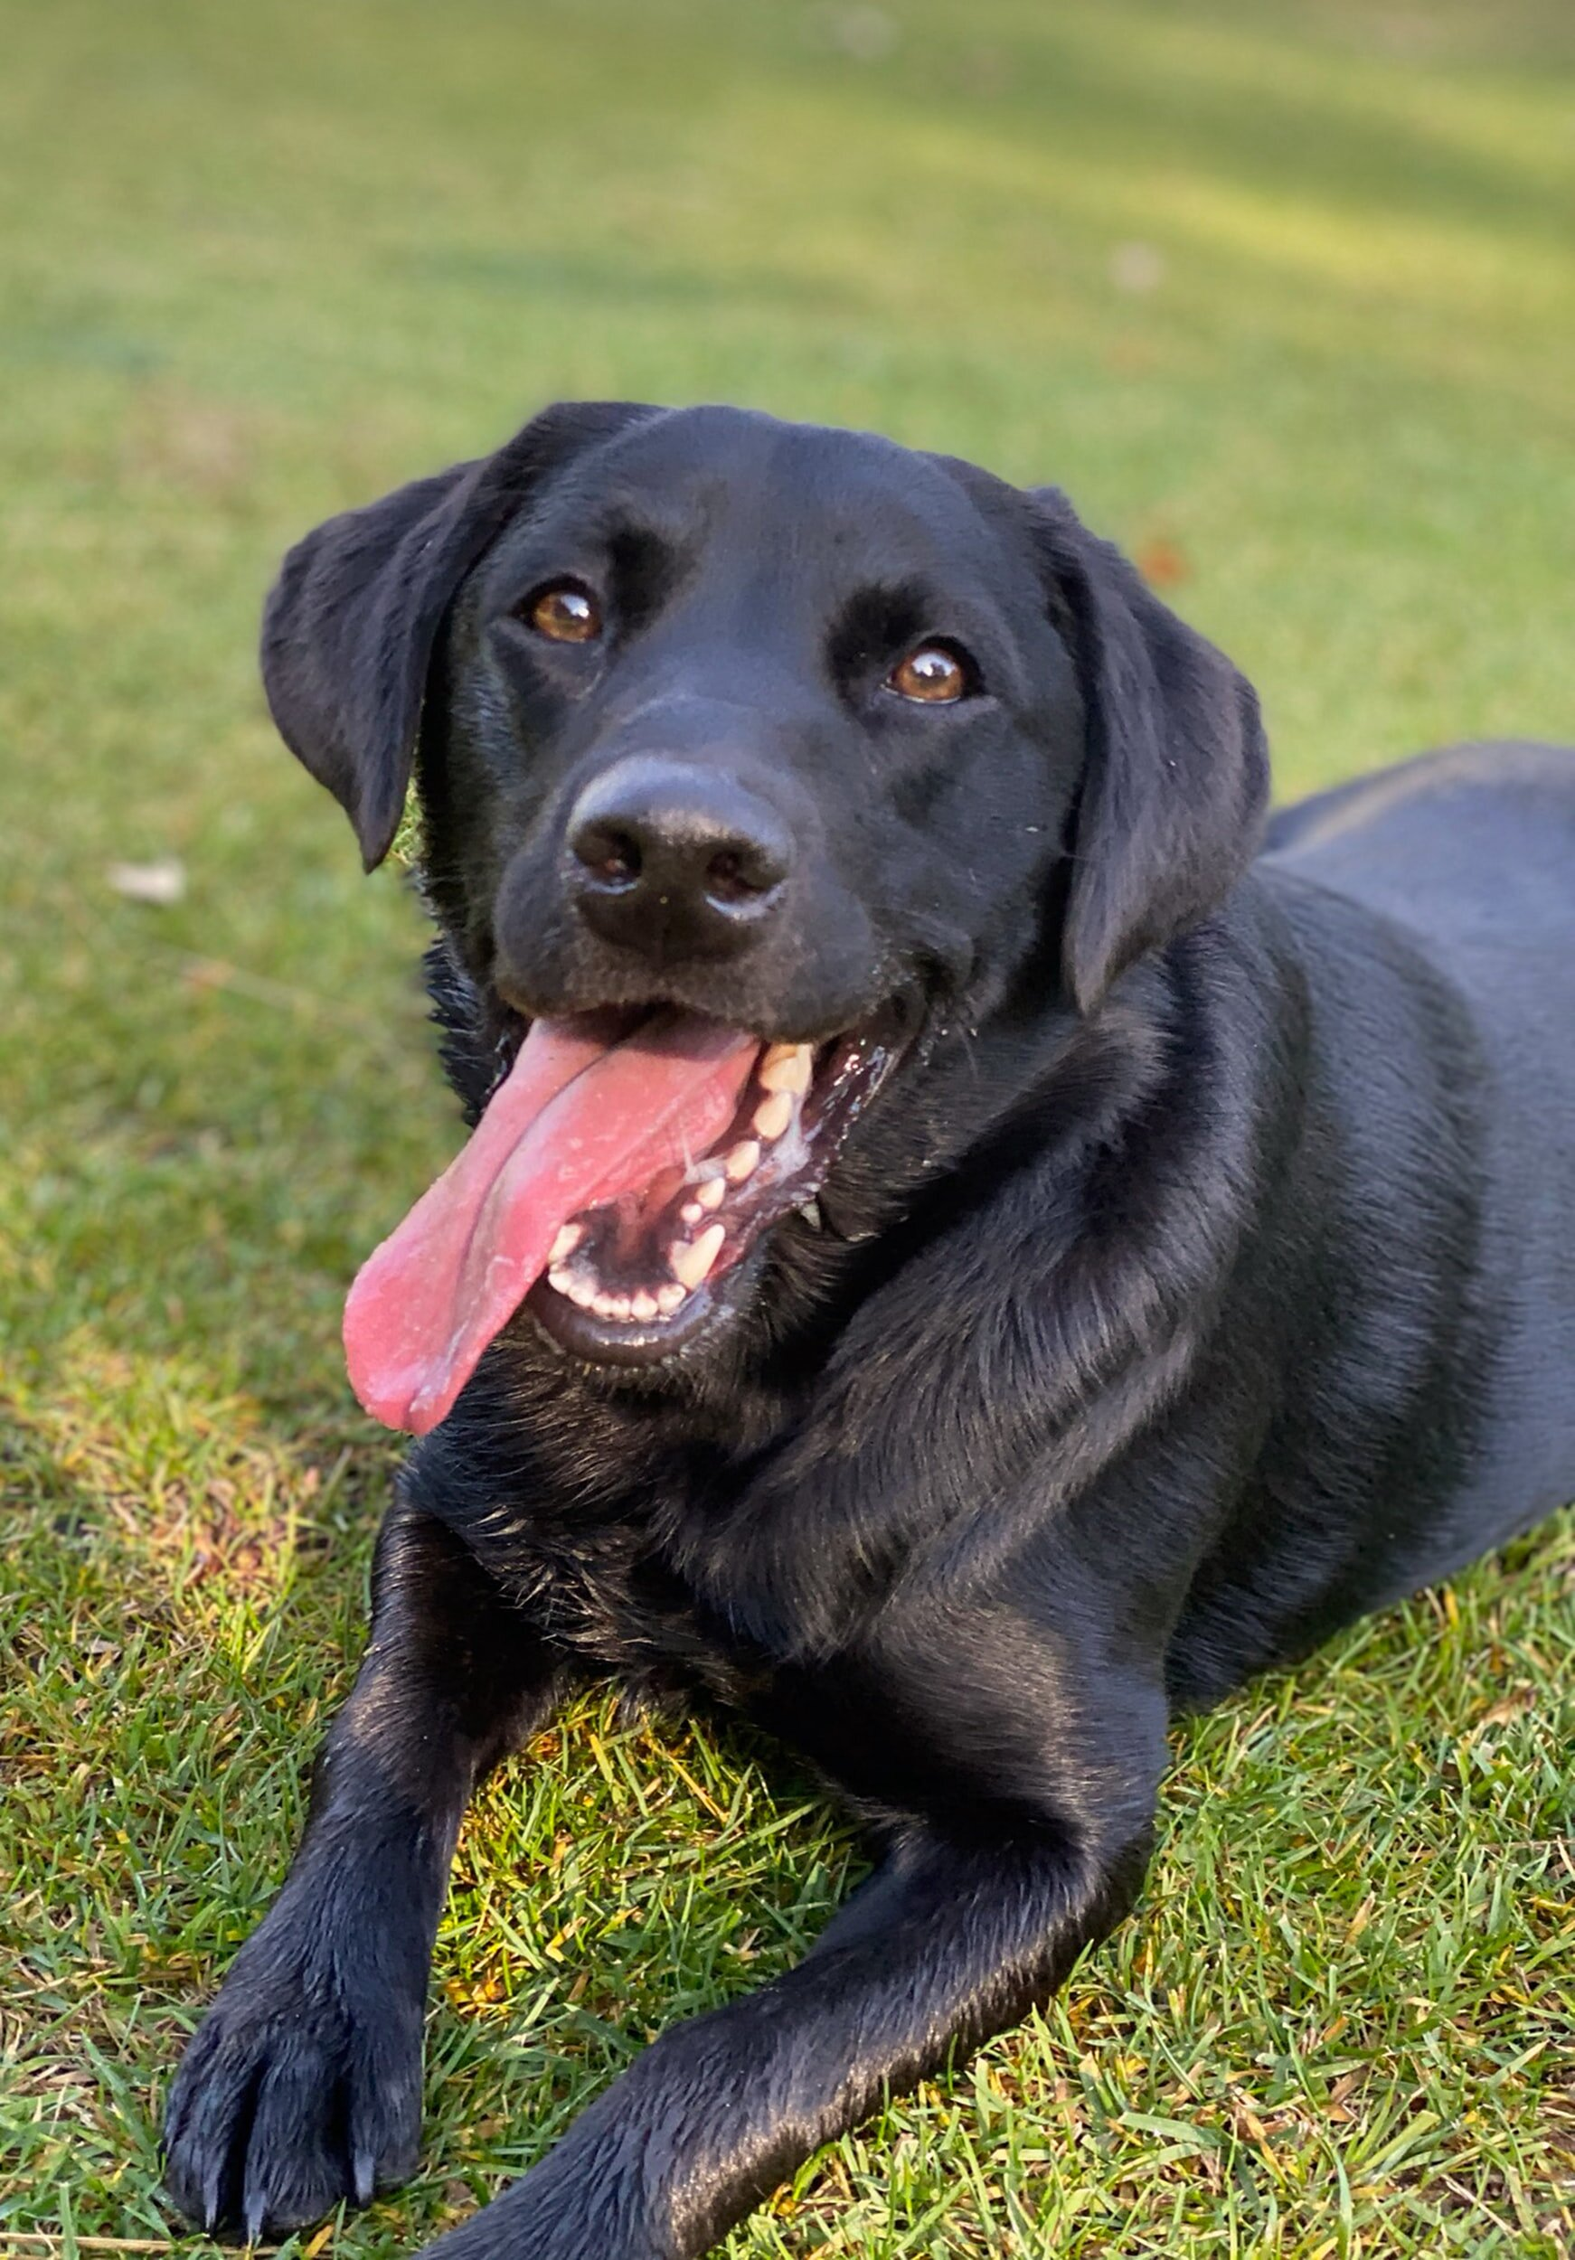
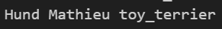
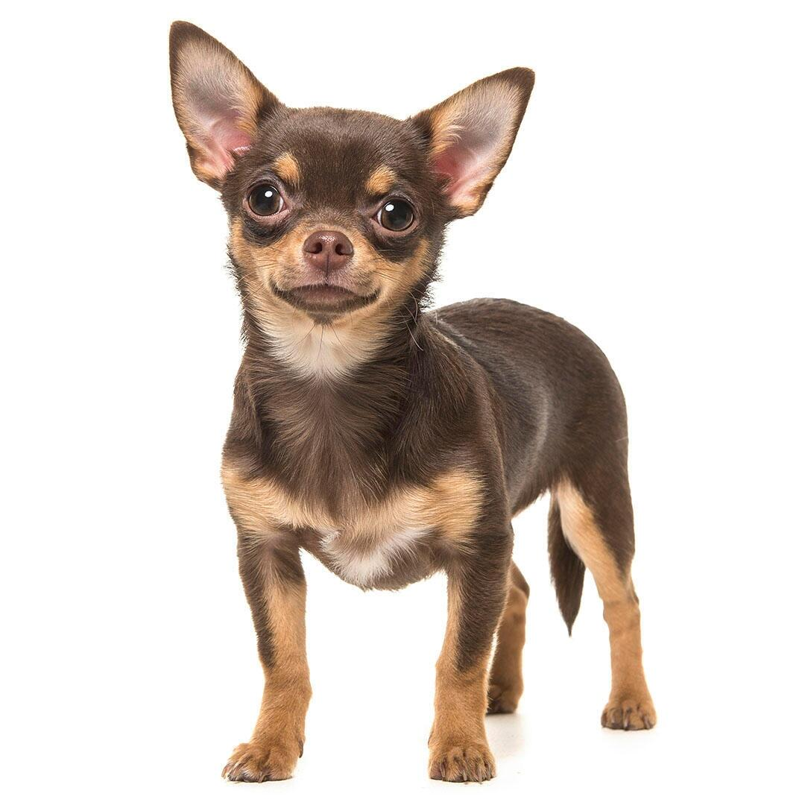

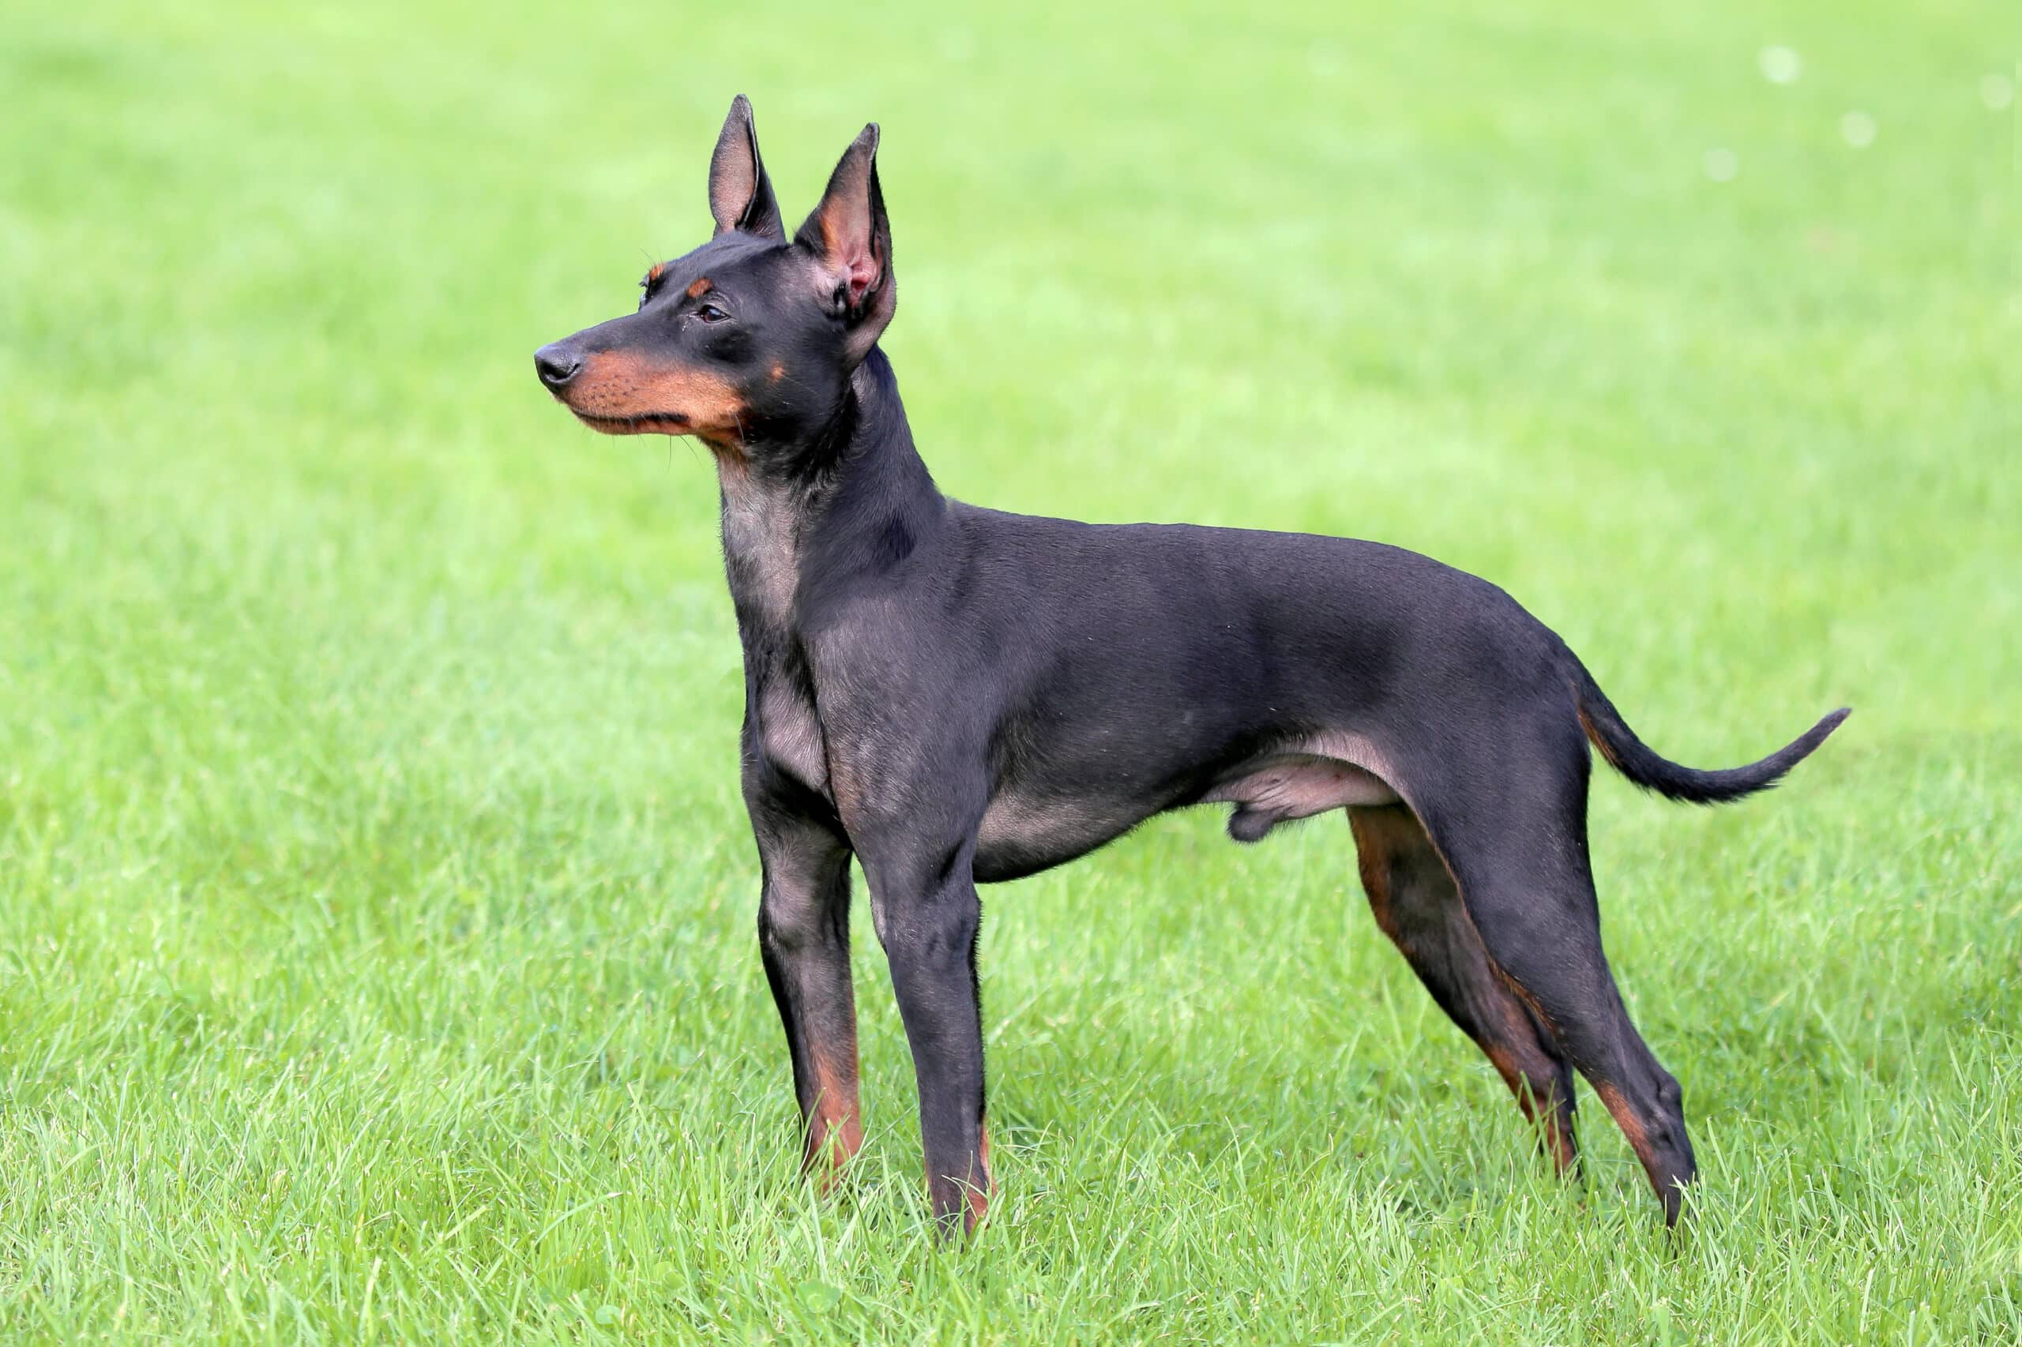
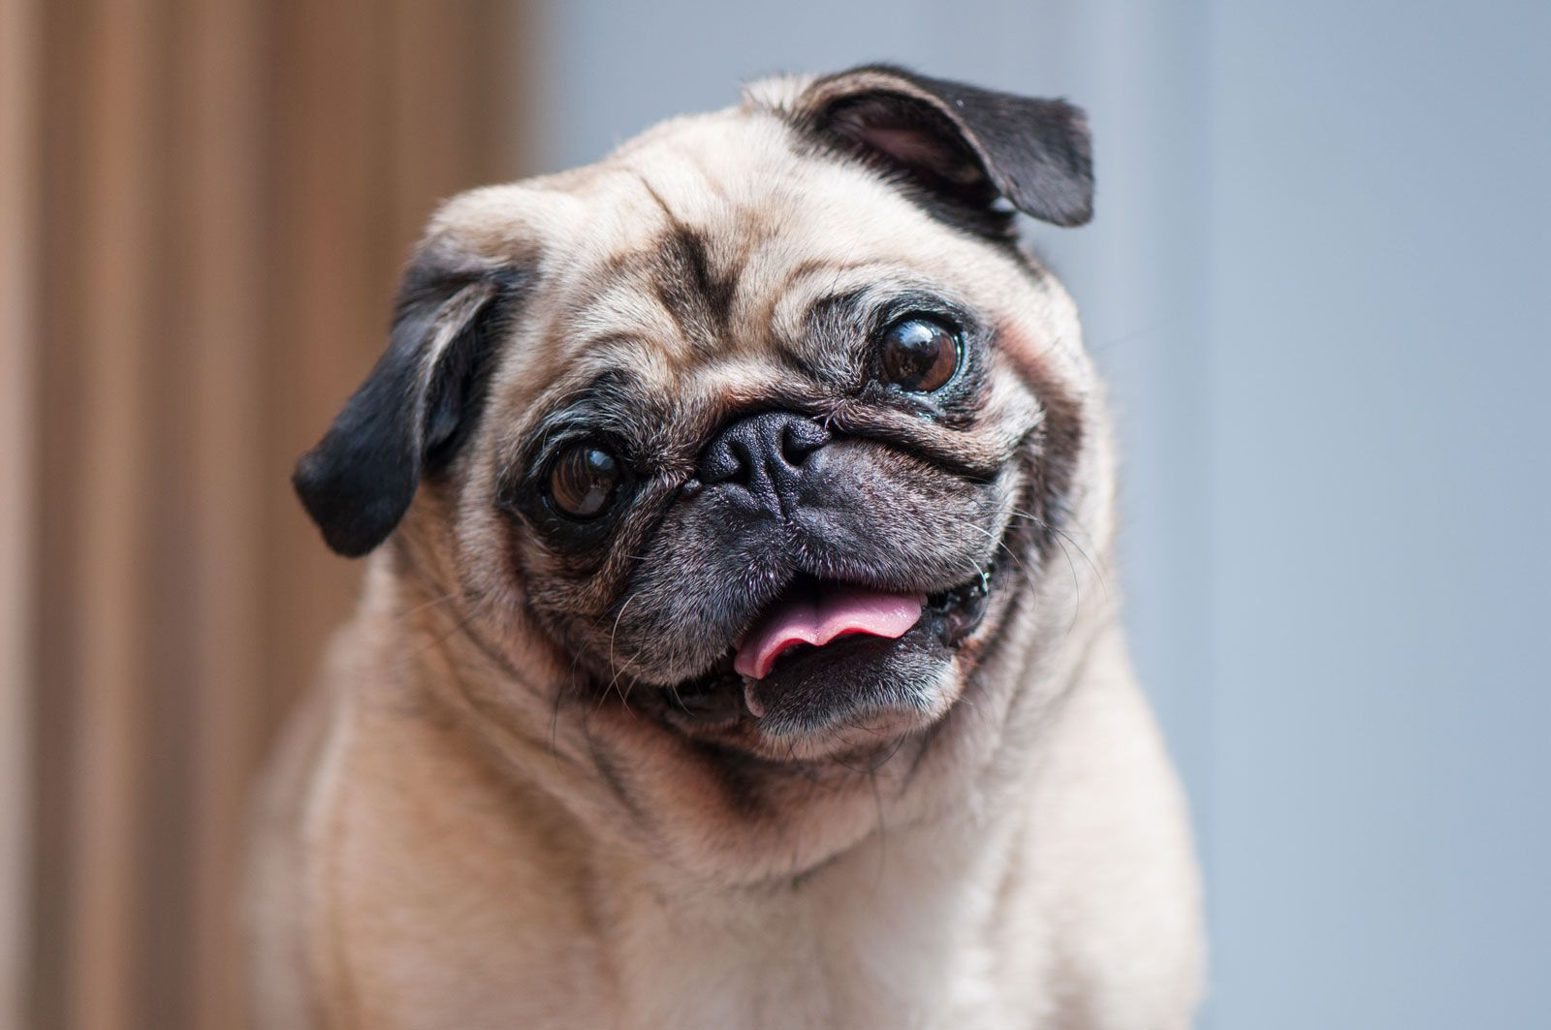
What Breed Am I?

